Slide 1
PROJECT PROPOSAL
Fruit and vegetable recognition &calorie counter
Presented by Sandra S Santhosh

Slide 2
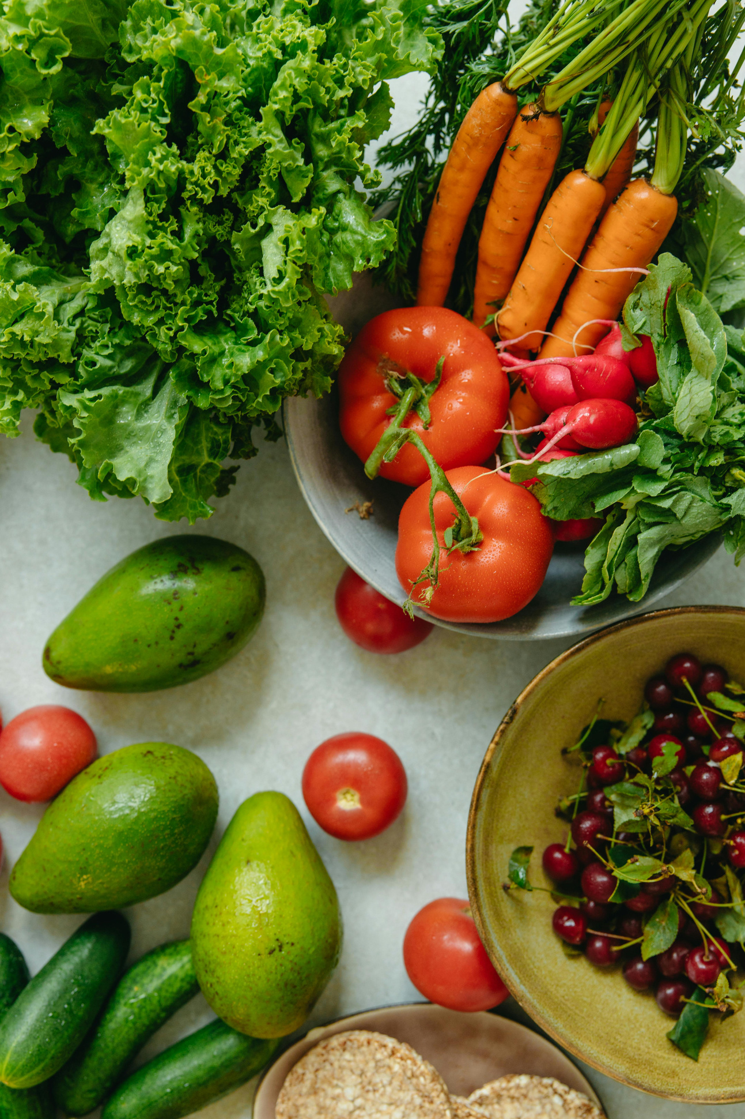
Content
01
Introduction
02
literature review 1
03
literature review 2
04
literature review 3
05
Summary
06
Project proposal
07
Conclusion

Slide 3
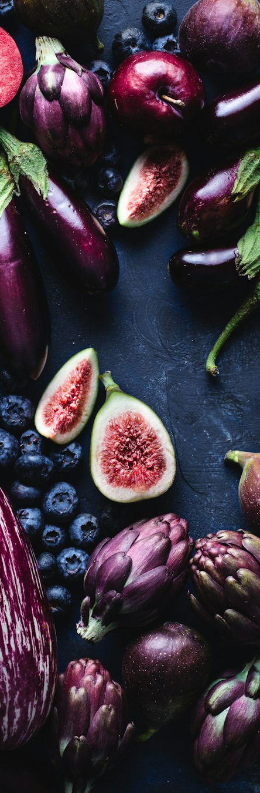
Introduction
In today’s health-conscious world, managing dietary intake can be challenging and prone to errors.
Our proposal seeks to simplify this task by identifying the image and generating the calories of the provided fruit or vegitable.
Aims to utilize deep learning techniques to recognise the image and web scraping to get the calories.
The dataset is source from kaggle with 36 classes .

Slide 4

Literature Review

Slide 5
1. “Hyperspectral fruit and vegetable classification using convolutional neural Networks”
It was published in the journal Computers and Electronics in Agriculture on July 1, 2019
Domain: Classifying hyperspectral of images fruits and vegetables using deep learning models like CNN.
Dataset: Is developed manually, includes 2700 images with 16 spectral bands and various features, categorized into 13 fruit and vegetable labels.
A modified version of the GoogLeNet architecture, specifically designed for hyperspectral data, is employed for feature extraction and classification. This model uses the Inception Module to capture multi-scale features.

Slide 6
For finetuning the hyperspectral images they use 3 architectures:
Pseudo-RGB model
Kernel model
Linear Combination Model
Accuracy:
Pseudo-RGB model:88.15%
Kernel model : 92.23%
Linear Combination Model:85.93%

Slide 7
2.”Food Calorie Estimation using Convolutional Neural Network”
2021 3rd International Conference on Signal Processing and Communication (ICPSC).
Domain: The study proposes using a deep learning model, specifically a CNN, to estimate food calories from images.
Dataset:The dataset sourced from the ECUSTFD dataset, includes 2978 images with features such as volume, mass, and calorie information. It encompasses 19 food categories and various target variables.
CNN is the primary architecture used for food image classification and calorie estimation. Support Vector Machine (SVM) and Random Forest are the other algorithms used for image classification.

Slide 8
Accuracy:
Convolutional Neural Network (CNN) model is 92%.
Random Forest:
Mean Error: 13.12
K-Nearest Neighbors (KNN):
Mean Error: 21.06
Mean error of KNN is greater than Random forest indicating relatively less accurate performance in this study.

Slide 9
3.”Automatic Fruits Calories Estimation through
Convolutional Neural Networks “
6th International Conference on Computer and Technology Applications, April 2020.
Domain: The study proposes using a deep learning model, specifically a Deep Convolutional Neural Network (DCNN), to estimate the calorie content of fruits and vegetables from images captured of food plates.
Dataset:The study uses a dataset of 41,509 images, categorized into 16 classes of fruits and vegetables, with around 4,000 images per class. Fruit-360 dataset from Kaggle, used for comparison.
For automatic recognition of fruits and vegetables and estimation of calorie content Deep Convolutional Neural Networks (DCNNs) is used.

Slide 10
Various CNN models with different numbers of layers (9, 11, and 15 layers) are used to enhance accuracy in both recognition and calorie estimation.
Accuracy:
CNN Model 1(9 layers): 87% to 96% (varies by fruit)
CNN Model 2(11 layers): 81% to 95% (varies by fruits)
CNN Model 3(15 layers): Up to 96% for fruits and 95% on the Fruit-360 dataset.

Slide 11
Summary
TITLE
YEAR
JOURNEL NAME/PUBLISHER
SUMMARY
HYPERSPECTRAL FRUIT AND VEGETABLE CLASSIFICATION USING CONVOLUTIONAL NEURAL NETWORKS, Jan Steinbrenera, Konstantin Poschb,Raimund Leitner | 2019 | IT WAS PUBLISHED IN JOURNAL COMPUTERS AND ELECTRONICS IN AGRICULTURE ON JULY 1, 2019 | PSEUDO RGB MODEL-88.15% LINEAR COMBINATION MODEL-85.93% KERNEL MODEL:92.23%
FOOD CALORIE ESTIMATION USING CONVOLUTIONAL NEURAL NETWORK, V. Balaji Kasyap, N. Jayapandian | 2022 | 2022 INTERNATIONAL CONFERENCE ON INTELLIGENT COMPUTING AND APPLICATIONS (ICICA) | CNN MODEL ACCURACY: 92% MEAN AVERAGE PRECISION (MAP): 1 COMPLETE MEAN VOLUME ERROR: 21.06 HIGH ERRORS FOR CERTAIN FOODS LIKE KIWI, MOON CAKE, AND MANGO
AUTOMATIC FRUITS CALORIES ESTIMATION THROUGH CONVOLUTIONAL NEURAL NETWORKS, Ghazanfar Latif, Batool Alsalem, Wejdan Mubarky, Nazeeruddin Mohammad, Jaafar Alghazo | 2022 | 6TH INTERNATIONAL CONFERENCE ON COMPUTER AND TECHNOLOGY APPLICATIONS, PRESENTED AT ICCTA | CNN MODEL 1(9 LAYERS): 87% TO 96% (VARIES BY FRUIT) CNN Model 2(11 LAYERS): 81% TO 95% CNN Model 3(15 LAYERS): UP TO 96% FOR FRUITS AND 95% ON THE FRUITS-360 DATASET

Slide 12
Project proposal
All the three papers use CNN architecture to recognise the images .
I propose a fruit and vegetable recognition and calorie counter system using CNN architecture by incorporating the two aspects, recognition and calorie couting into a single system.
Additionally, a web interface will be created to allow users to input images and the system will recognise it and generate the calorie content of fruit or vegitable in that image.

Slide 13
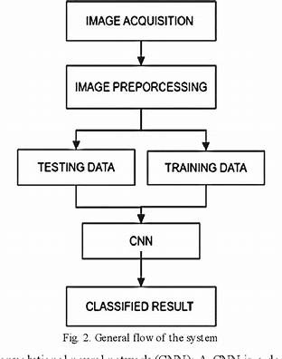
Methodology
The project will follow a structured methodology encompassing data preprocessing, model development, training, evaluation, and deployment.
Data Preprocessing
Normalize images
Resize images
Model development
Training the Model
Evaluation and Testing
Post-Processing
Deployment

Slide 14

Dataset
The dataset is taken is “Fruits and Vegetables Image Recognition Dataset”. The dataset is organized into three main folders:
Train: Contains 100 images per class.
Test: Contains 10 images per class.
Validation: Contains 10 images per class.
The train, test and validation folders have 36 classes of different fruits and vegetables.
Training dataset consist of 100 images each, i.e 3600 images in trainig dataset.The test and validation dataset has 10 images for each class, i.e 360 images in test dataset and 360 images in validation dataset.

Slide 15
Conclusion
Proposal outlines the development of a Fruit and vegetable recognition & calorie counter web app which can enable users in promoting healthy eating habits and supporting dietary management.
By offering precise calorie information,such systems assist users in tracking their nutritional intake, which is crucial for weight management, diet planning, and overall health monitoring

Slide 16
Thank
You

